Slide 1

Lecture 02
Introduction to the Personal computer- PII
CT4005NI - Computer Hardware and Software Architectures

Slide 2
Lecture 02’s Objectives
Describe a computer system.
Concept of CPU and different types of CPU socket.
Advance features of CPU,
Concept of Computer Memory,
Classification of RAM,
Internal components of Motherboard.

Slide 3
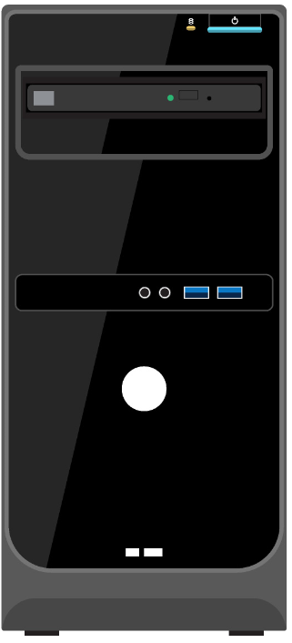
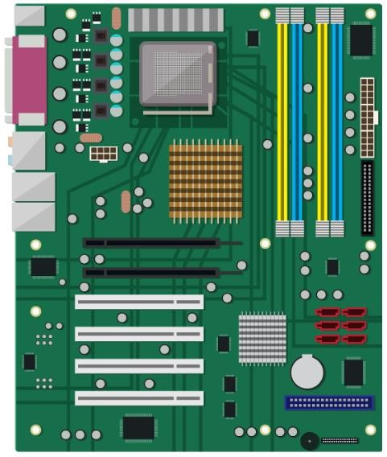
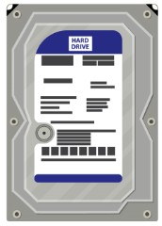

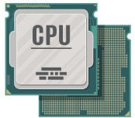
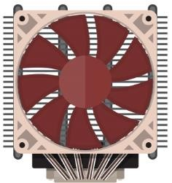
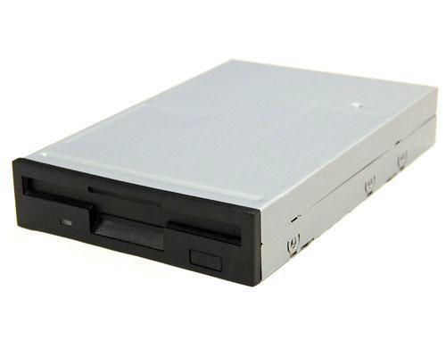
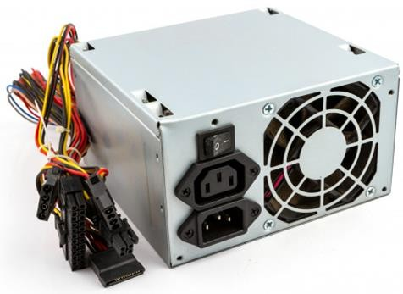
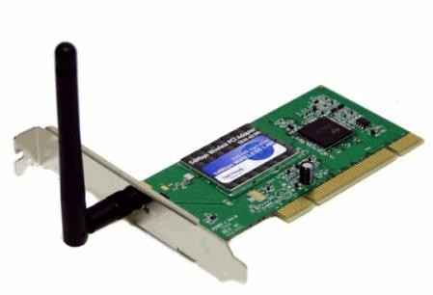
Recap : Internal components

Slide 4
Recap
Module description
IT Certifications
Computer case and their firmware:- Mini-ITX, Micro-ATX, ATX and EATX
Power Supply Units and their power connectors:- P1 24-pin, 4-Pin Molex and Mini Molex (Berg), 15-pin SATA, 6/8-pin PCIE and 4-pin power connector
PSU color coding : (orange:+3.3V, Red:+5V, White:-5V, yellow:+12V, blue:- -12V)
Internal components: Hard disks, RAM, Adapter cards, motherboard
Motherboard components: CPU Sockets, RAM slot, PCI Slots, SATA/PATA ports, power connector ports, chipsets, I/O ports, CMOS and so on.

Slide 5
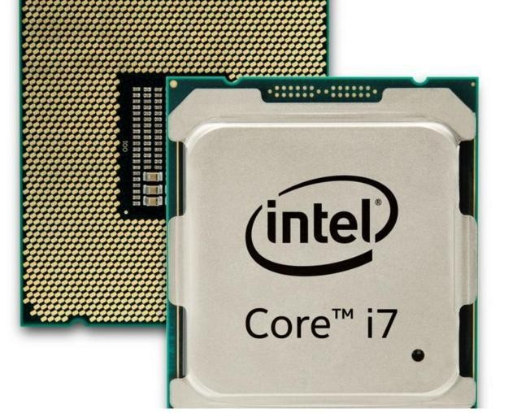
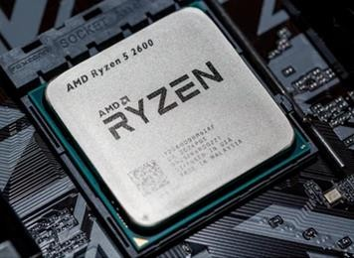
2.1 Internal Components : CPU
The central processing unit (CPU) is considered the brain of the computer.
Most calculations take place in the CPU.
CPUs come in different form factors, each style requiring a particular slot or socket on the motherboard.
Intel
AMD

Slide 6
2.1 Internal Components : CPU
Unlike Slot-based processors, most CPU sockets and processors in use today are built around the Pin Grid Array (PGA) architecture, in which the pins on the underside of the processor are inserted into the socket, usually with Zero Insertion Force (ZIF).
The CPU executes a sequence of stored instructions
called a Program.

Slide 7
2.2 Motherboard Components : CPU Sockets
A CPU socket is the place where we actually place a CPU in the Motherboard.
They are commonly either LGA or PGA with a ZIF mechanism.
Well known CPU manufacturers are Intel and AMD.
Common Intel Sockets
LGA 775
LGA 1156
LGA 1366
LGA 1155
LGA 2011
LGA 1150
Common AMD Sockets
Socket AM2
Socket AM3
Socket AM3+
Socket FM1
Socket FM2
Socket FM2+

Slide 8
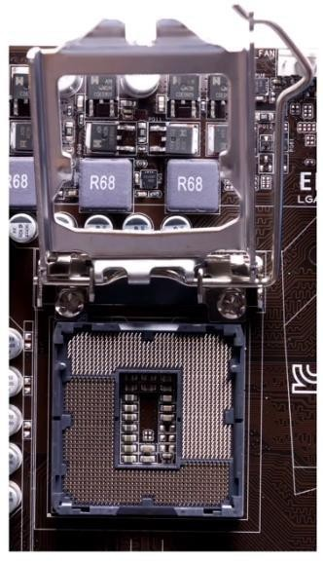
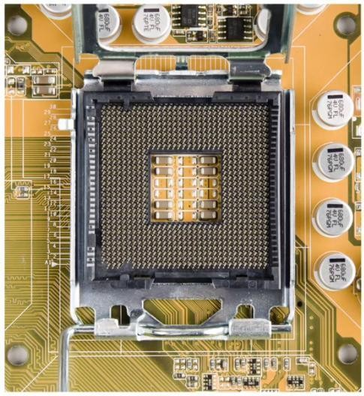
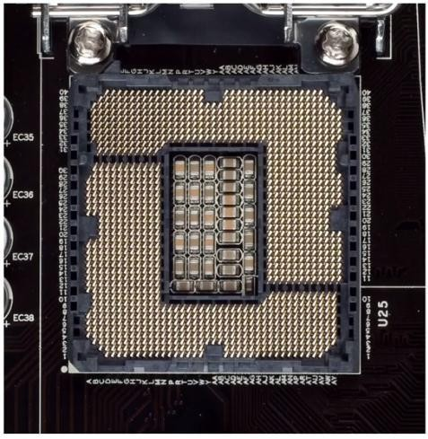
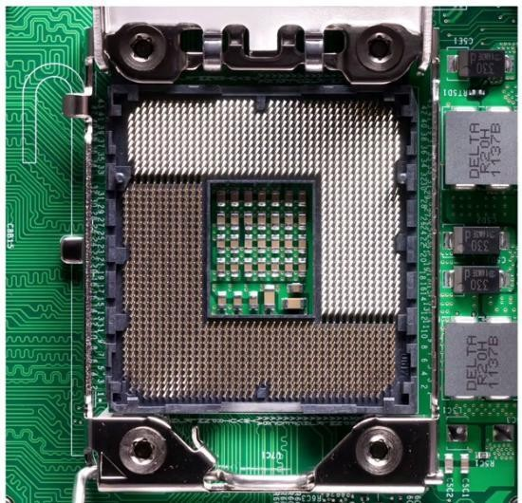
2.2 Motherboard Components : CPU Sockets
Common Intel Sockets
LGA 775
LGA 1156
LGA 1366
LGA 1155

Slide 9
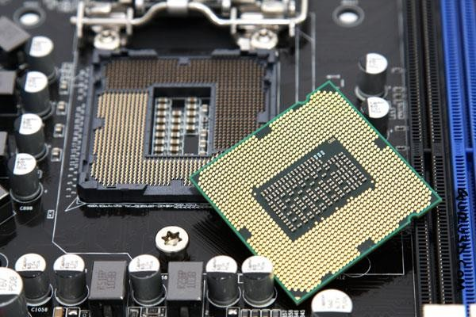
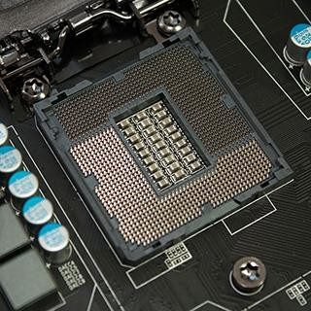
2.2 Motherboard Components : CPU Sockets
Common Intel Sockets
LGA 1155 (i5 CPU)
LGA 1150 (i7 CPU)
LGA 1150 (i3 CPU)
2nd Gen Sandy bridge uses LGA 1155 3rd Gen Ivy Bridge uses LGA 1155 4th gen Haswell uses LGA 1150
5th Gen broadwell uses LGA 1150

Slide 10
2.3 CPU - Advanced Features
While the CPU is executing one step of the program, the other instructions and data are stored in cache memory.
CPU Architecture x86 and x64:
x86 or 32 bit CPU architecture registers to store values of up to 2^32 = 4 billion, 294 million, 967 thousand and 296
x64 or 64 bit CPU architecture registers to store values of up to 2^64 = 18 quintillion, 446 quadrillion, 744 trillion, 073 billion, 709 million, 551 thousand 616

Slide 11
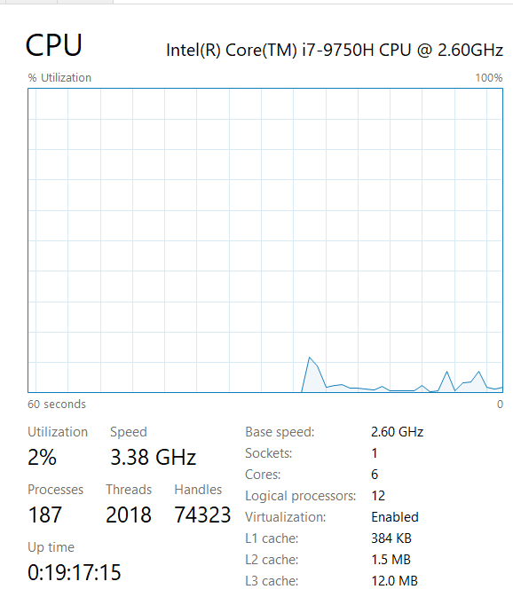
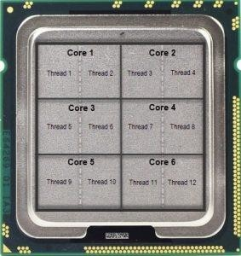
2.3 CPU - Advanced Features
Hyper threading
It is used to enhance performance of the CPU where multiple pieces of code would be executing simultaneously on each pipelines.
To an operating system, a single CPU with hyper threading performs as though there are two CPUs.

Slide 12
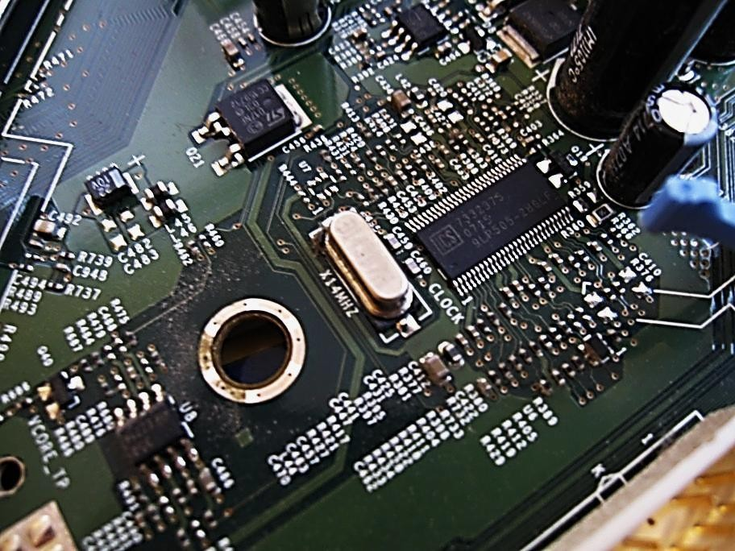
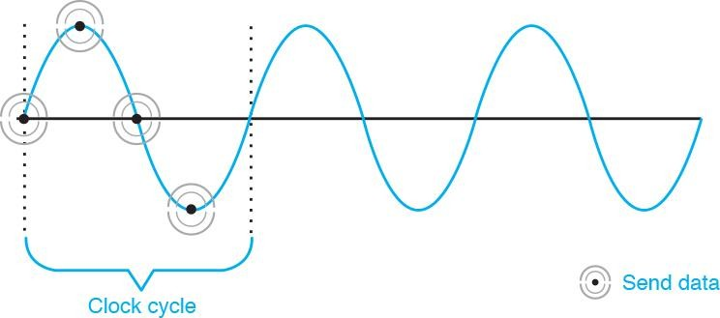
2.3 CPU - Advanced Features
Speed measurement : clock speed
The power of a CPU is measured by the speed and the amount of data that it can process.
The speed of a CPU is rated in cycles per second. Example MHz, GHz.
The amount of data that a CPU can process at one time depends on the size of the
processor data bus (FSB) or the system
crystal.

Slide 13
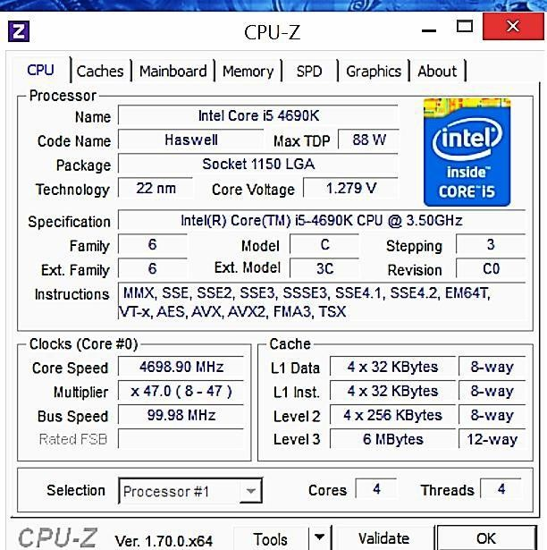
2.3 CPU - Advanced Features
Overclocking
Makes processor to work at a faster speed than normal but can result damage to CPU.

Slide 14
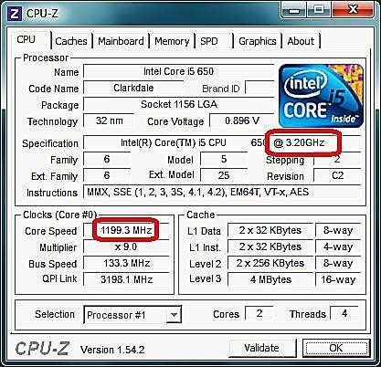
2.3 CPU - Advanced Features
CPU Throttling
Processor runs at less than the rated speed
to save power and produces less Commonly used in Laptops and Mobile devices.
heat

Slide 15
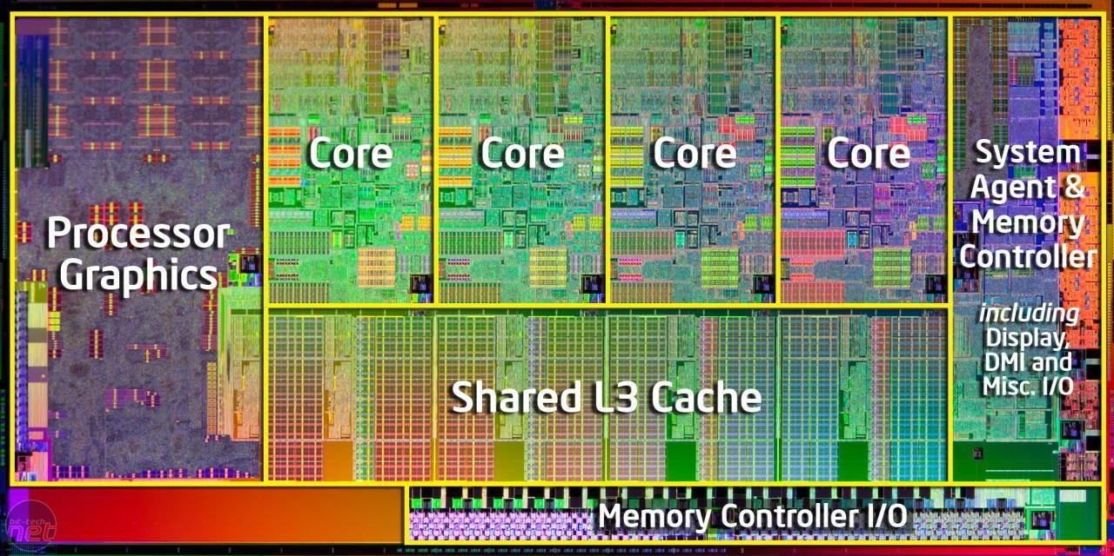
2.4 CPU - Cores
A CPU contains one or more execution blocks which are known as core(s)
More cores can execute more than one set of instructions simultaneously
Type on the basis of cores
Single Core - one core inside a single CPU that handles all the processing.
Dual Core - Two cores and both can process information at same time.
Triple Core - Quad-core with one processor disabled.
Quad Core - Four cores and all can process information simultaneously.
Others - Hexa, octa, deca and dodeca cores

Slide 16
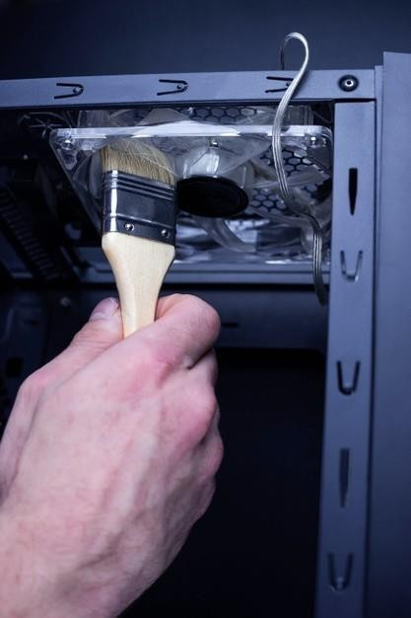
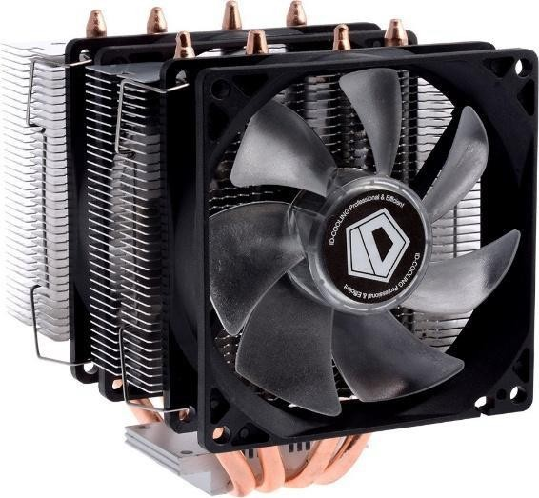
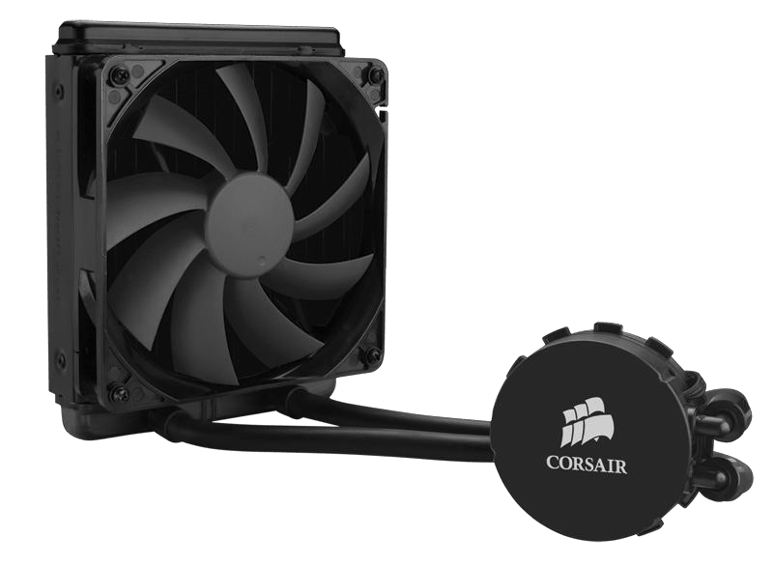
2.5 Internal Components : Cooling systems
Electronic components generate heat which is caused by the flow of current within the components.
Case Fans - It increases the air flow in the computer case to remove the heat generated inside.
CPU Fans - A heat sink at bottom of CPU Fans draws heat from the core of the CPU and Fan moves it away.
Graphics Card Cooling System - Fans are dedicated to cool the graphics-processing unit (GPU).
Computers with extremely fast CPUs and GPUs may use a water-cooling system where a metal plate is placed over the processor and water is pumped over the top to collect the heat that the CPU creates.

Slide 17
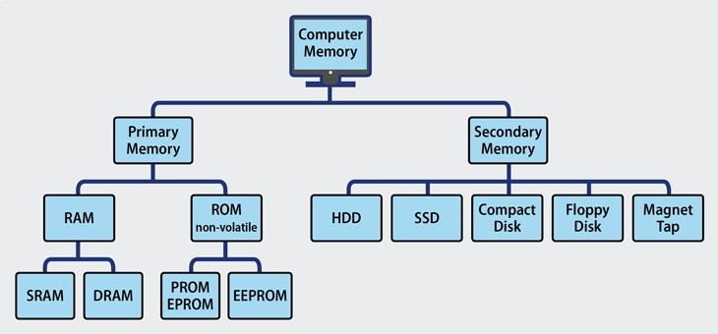
2.6 Internal Components : memory

Slide 18
2.6 Computer memory : Primary
Directly accessed by the CPU
Also known as primary memory
ROM - Read Only Memory
RAM - Read Access Memory
Cache memory
RAM and cache are volatile
while ROM is non-volatile

Slide 19
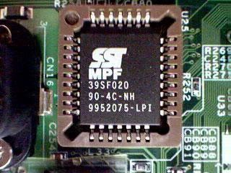
2.7 Primary memory : ROM
ROM (Read Only Memory)
It contains instructions that can be directly accessed by the CPU.
ROM chips are non-volatile and are located on the motherboard.
Basic instructions for booting the computer and
loading the operating system are stored in ROM.
Its contents can't be erased by normal means.
Types: ROM, PROM, EPROM, EEPROM

Slide 20
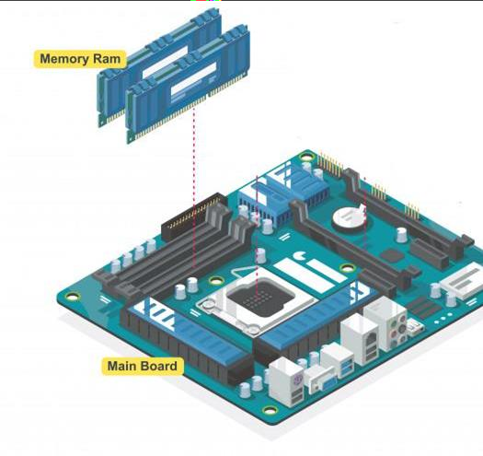
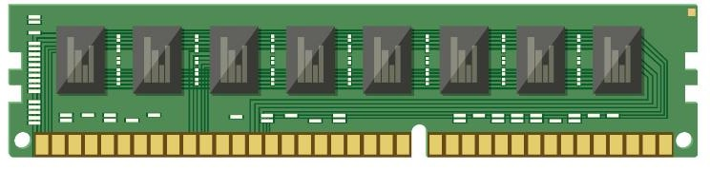
2.8 Primary memory : RAM
RAM (Random Access Memory)
It is the temporary storage for data and programs that are being accessed by the CPU.
The more RAM in a computer, the more capacity the computer has to hold and process large programs and files, as well as enhance system performance.
Types: SRAM, DRAM, SDRAM, DDR (1,2,3 and 4) RAM

Slide 21
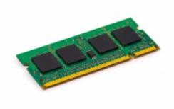
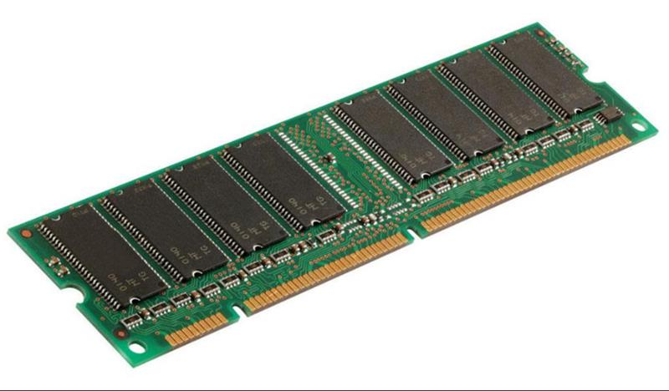
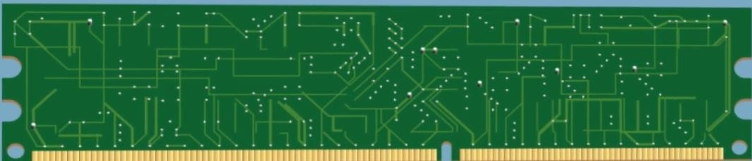
2.8 Primary memory : RAM
Memory Modules
Today's memory modules are the special circuit board with memory chips on it.
Types: DIMM (Dual Inline MM), SODIMM (Simple Outline DIMM), SIMM (Single Inline MM)
Single-sided memory modules only contain RAM on one side of the module.
Double-sided memory modules contain RAM on both sides of the module.

Slide 22
2.8 Primary memory : RAM
Types of DRAM:
DRAM- Dynamic RAM
SDRAM- Synchronous Dynamic RAM
DDR-SDRAM (Double Data Rate - Synchronous Dynamic RAM)
DDR2-SDRAM
DDR3-SDRAM
DDR4-SDRAM
DDR5-SDRAM

Slide 23
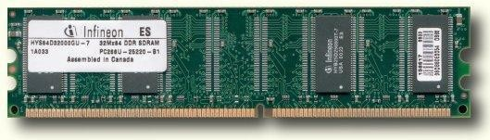
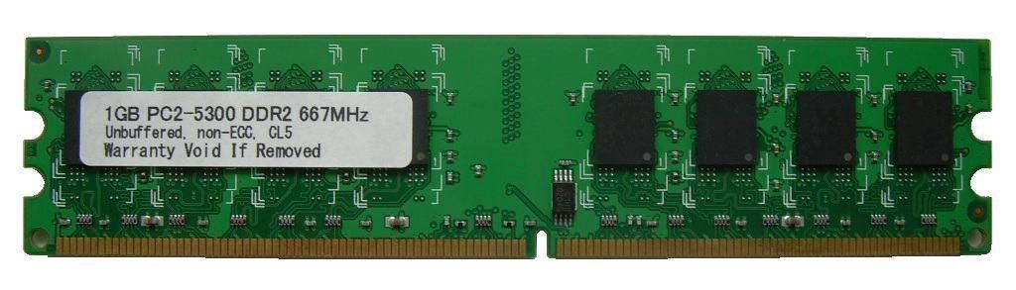
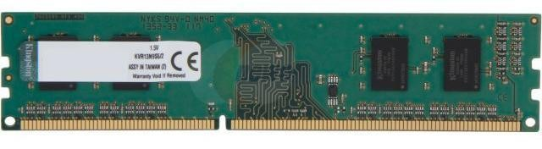
2.8 Primary memory : RAM
DDR - SDRAM
(184-pins)
DDR2 - SDRAM
(240-pins)
DDR3 - SDRAM
(240-pins)

Slide 24
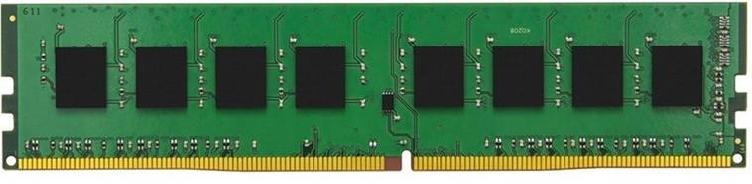
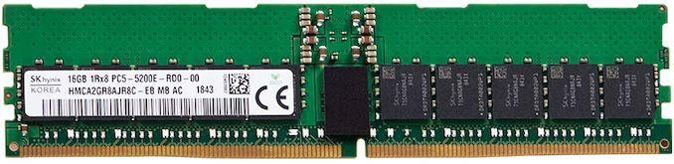
2.8 Primary memory : RAM
e. DDR4- SDRAM
(288-pins)
f. DDR5- SDRAM
(288-pins)

Slide 25
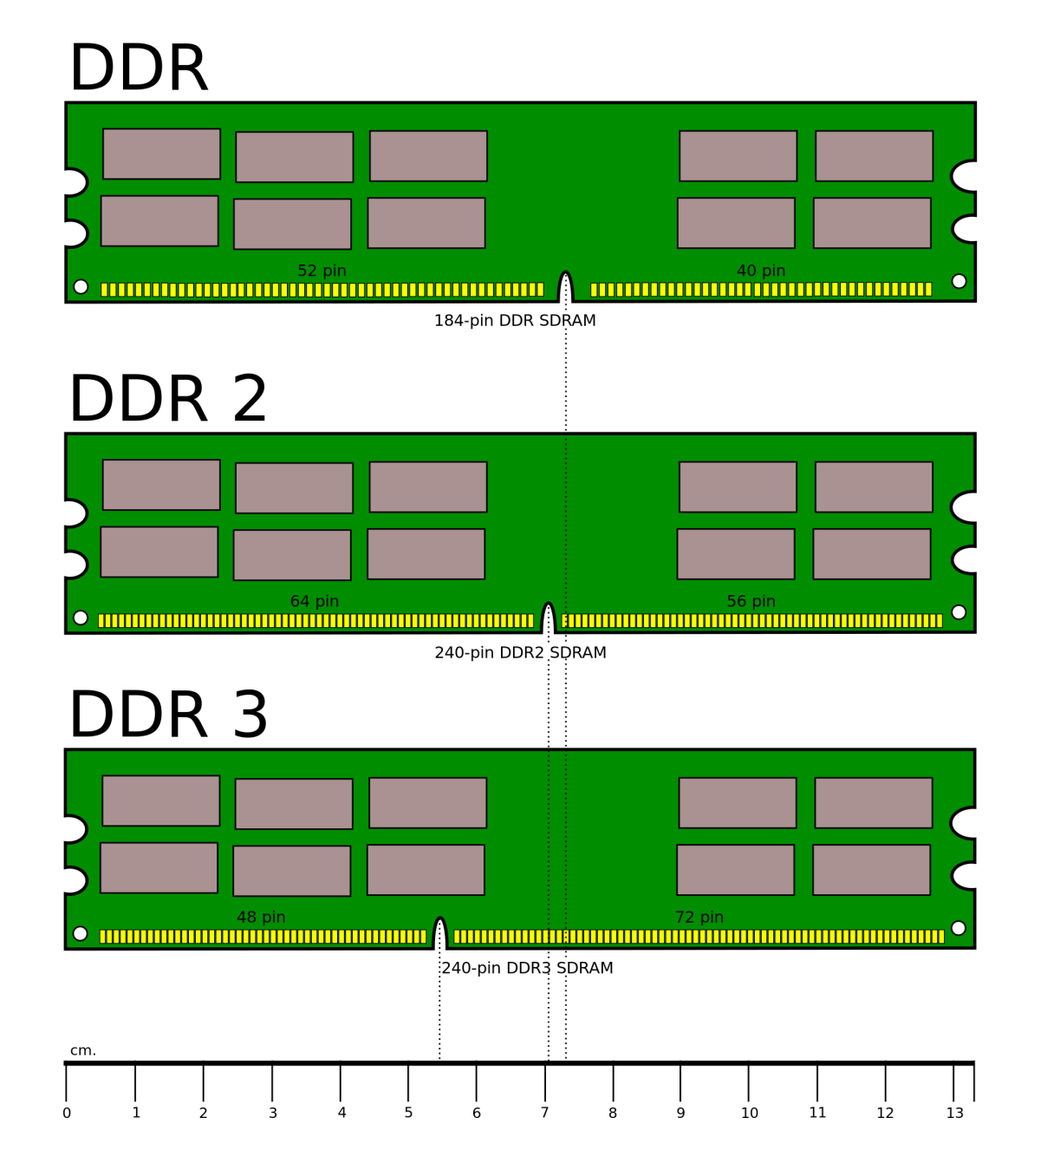
2.8 Primary memory : RAM
Comparison

Slide 26
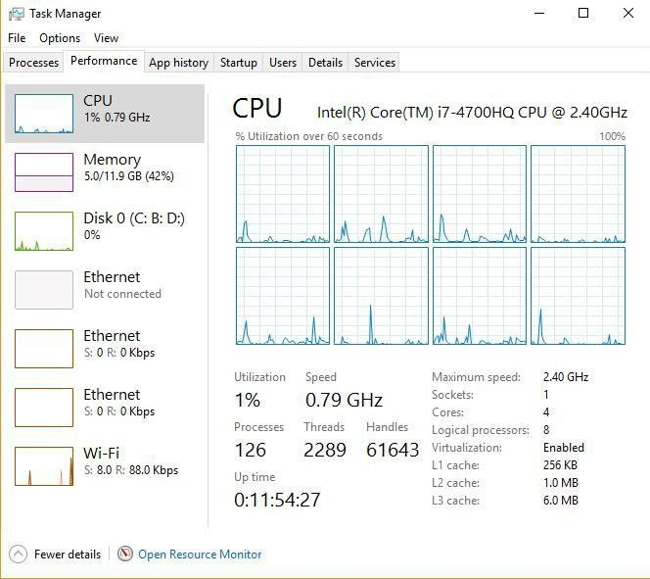
2.9 Primary memory : RAM
Cache Memory
SRAM is used as cache memory to store the most frequently used data and provides the processor with faster access to the data.
Types: L1, L2, L3

Slide 27
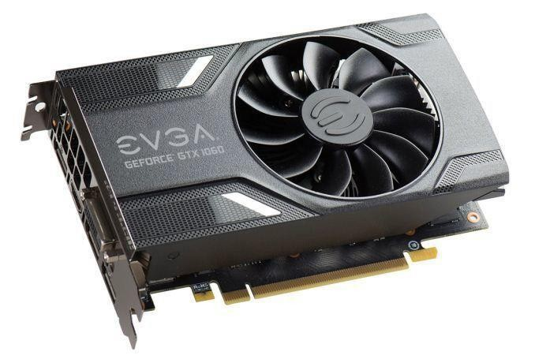
2.10 Internal Components : Adapter cards
Adapter cards increase the functionality of a computer by adding controllers for specific devices or by replacing malfunctioning ports.
Example: NIC, Wireless NIC, Sound and Video adapter, TV Tuner, Modem adapter, USB (Universal Serial Bus).

Slide 28
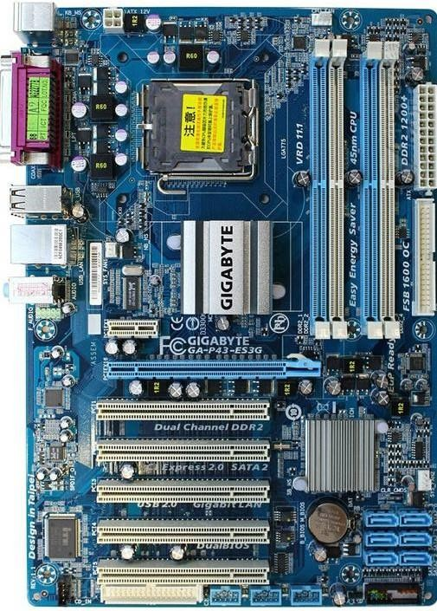
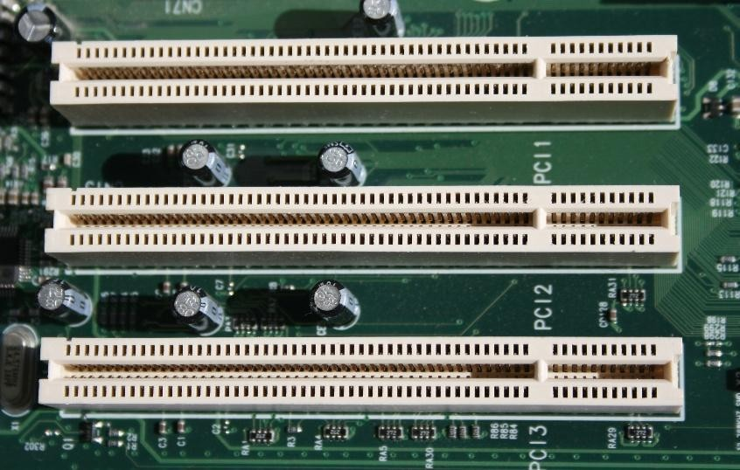
2.11 Motherboard Components : expansion slot
Three types:-
PCI : Peripheral Component Interconnect
AGP : Advanced Graphics Port
PCIe : Peripheral Component Interconnect Express
PCI : It is a 32-bit expansion slot and was used in most computers.
PCI in a Motherboard
PCI Slots

Slide 29
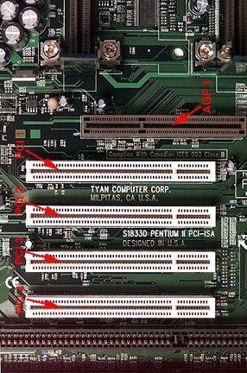
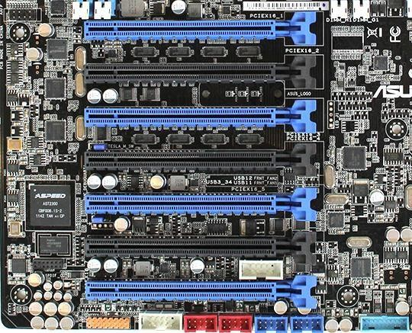
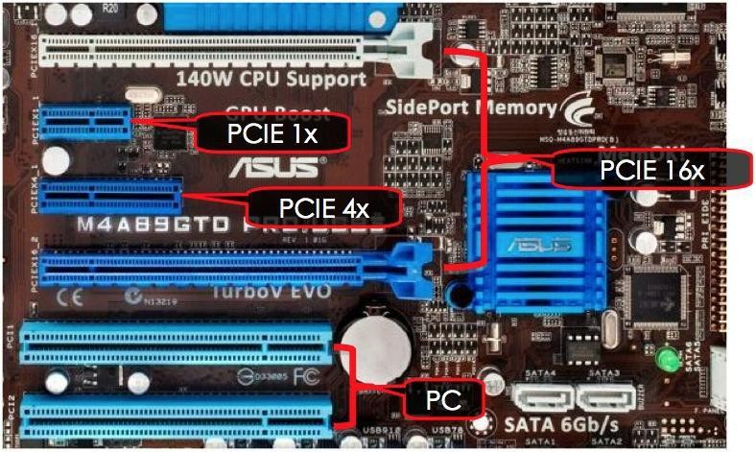
2.12 Motherboard Components : expansion slot
AGP (Advanced Graphic Port): It is a 32-bit expansion slot and is designed for video adapters.
PCIe (PCI Express): It is a serial bus expansion slot. It has replaced AGP as an expansion slot for video adapters and can be also used for other types of adapters.

Slide 30
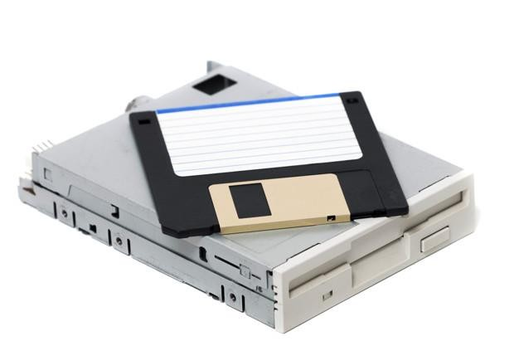
2.13 Internal Components : storage drives
Storage Drives
Storage Drives read or write information to magnetic or chip based or optical storage media.
The drive can be used to store data permanently or to retrieve information from a media disk.
Floppy Drive
A floppy drive, or floppy disk drive, is a storage device that uses removable 3.5-inch floppy disks (5.25-inch is obsolete).
Data Capacity - 720 KB or 1.44 MB.

Slide 31
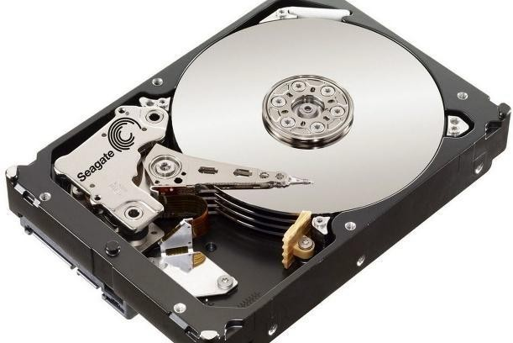
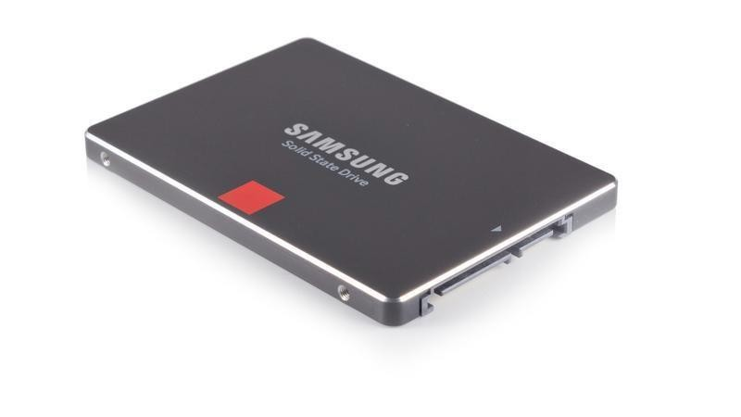
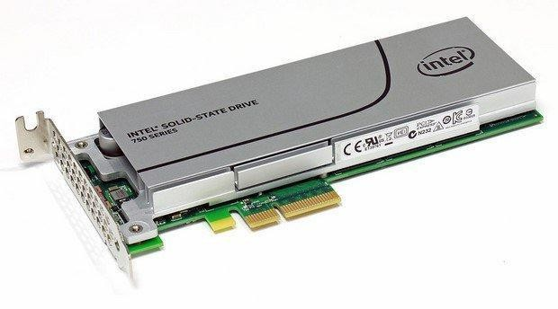
2.14 Internal Components : storage drives
Storage Drives -Hard Drive
A hard drive, or hard disk drive, is a magnetic storage device that is installed inside the computer.
The hard drive is used as permanent storage for data.
The storage capacity of a hard drive is measured in billions of bytes, or gigabytes (GB).
The speed of a hard drive is measured in revolutions per minute (RPM).
Multiple hard drives can be added to increase storage capacity.

Slide 32
2.14 Internal Components : storage drives
Newer Hard Disk Drive are SSDs (Solid State Drives).
It uses far less energy than traditional magnetic drives.
It has same form factor and uses ATA or SATA interfaces.
Hence, can replace magnetic drives.

Slide 33

End of Lecture for week 02
Any question ?

